Slide 1
Getting to the Core of the Oklahoma Academic Standards for Mathematics: Number and Operations in Middle School
Presented by Heather Sparks and Corbie Jackson
Taft Middle School
Oklahoma City Public Schools

Slide 2
Major Shifts
Focus
Coherence
Rigor

Slide 3
Focus
Fewer standards mean we will narrow and deepen the way time and energy are spent in the math classroom.
Solid conceptual understanding
High levels of procedural skill and fluency
Ability to solve problems inside and outside class

Slide 4
Coherence
Content progresses from grade to grade
Links to major topics within grades:
Grade Band | Focus Areas
K-2 | Addition & Subtraction: concepts, skills, problem-solving, and place value
3-5 | Multiplication & Division of whole numbers & fractions
6 | Ratios and proportional reasoning: early expressions & equations
7 | Ratios and proportional reasoning: arithmetic of rational numbers
8 | Linear algebra and linear functions

Slide 5
Rigor
Conceptual understanding
Procedural skill and fluency
Application in context
*All three pursued with equal intensity*

Slide 6
Standards for Mathematical Practice
Make sense of problems and persevere in solving them
Reason abstractly and quantitatively
Construct viable arguments and critique the reasoning of others
Model with mathematics
Use appropriate tools strategically
Attend to precision
Look for and make use of structure
Look for and express regularity in repeated reasoning

Slide 7
VOTE
Which practice standard will be most difficult for your students? Be ready to talk about why you think so.

Slide 8
Item Samples
Always, Sometimes, Never
Read through each statement. With your partner, decide if the statement is always true, sometimes true (and you can provide the exception), or never true.

Slide 9
Standards for Mathematical Practice
Make sense of problems and persevere in solving them
Reason abstractly and quantitatively
Construct viable arguments and critique the reasoning of others
Model with mathematics
Use appropriate tools strategically
Attend to precision
Look for and make use of structure
Look for and express regularity in repeated reasoning

Slide 10
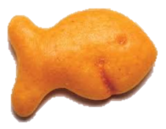
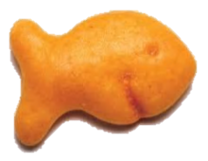
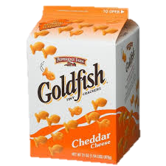
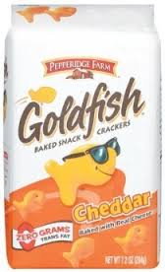
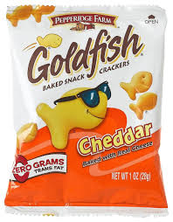
Item Samples
Goldfish

Slide 11
Standards for Mathematical Practice
Make sense of problems and persevere in solving them
Reason abstractly and quantitatively
Construct viable arguments and critique the reasoning of others
Model with mathematics
Use appropriate tools strategically
Attend to precision
Look for and make use of structure
Look for and express regularity in repeated reasoning

Slide 12
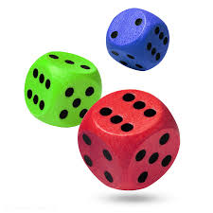
Item Samples
Playing Three Dice Math
-Roll 3 six-sided dice.
-Using each number once with
addition, subtraction, multiplication
or division to get an answer. Color
that number in on your game board.
ex: (3 + 2) x 6 = 30 or 6 – (3 + 2) = 1
-First person to color in three numbers in a row
wins.

Slide 13
What makes a good item or task?
Age appropriate
Has multiple “entry” points
You enjoy the task

Slide 14
Excellence Resources
www.yummymath.com Real-world student-centered tasks
http://emergentmath.com/my-problem-based-curriculum-maps/ Geoff Krall’s CCSS curriculum maps with links for suggested tasks
https://docs.google.com/spreadsheet/pub?key=0AjIqyKM9d7ZYdEhtR3BJMmdBWnM2YWxWYVM1UWowTEE&output=html Dan Meyer’s Three-Act Math Tasks organized by CCSS
http://msmathwiki.pbworks.com/ Middle school math wiki (Teachers submit ideas, have conversations about topics and share resources)
http://map.mathshell.org Math Assessment Project Tasks
http://visualpatterns.org/ Photos of the first three stages of a pattern (kids can create and submit their own here, too!)
http://robertkaplinsky.com/lessons/ Student-centered task ideas organized by grade level and strand
http://graphingstories.com/ Videos of real life experiences that can be transposed to graphs
http://mathmistakes.org This site is about compiling, analyzing and discussing mathematical errors that students make.
http://www.learner.org/workshops/missinglink/ The Missing Link professional development series for teachers
www.parcconline.org PARCC information and sample assessment items for CCSS.
http://www.smarterbalanced.org/pilot-test/ SmarterBalanced website with online pilot test that mimics what students will likely see on future assessments

Slide 15
Questions?
This presentation will be housed electronically at
www.hisparks.com/presentations.html
Corbie Jackson Heather Sparks
cljackson@okcps.org hesparks@okcps.org

